Slide 1

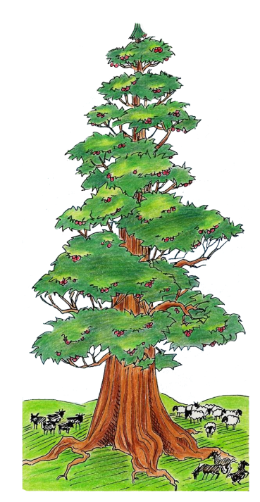

Slide 2


#3 of 8
Declaring the END
From the Beginning
Notes:
Terra Bella Oct 2011
Dan 4 Part 1 [0f 3] – Understanding Literal Language
Slides #1-59
Narrate: 55 min
#3 Terra Bella
Presentation
Oct 2011

Slide 3

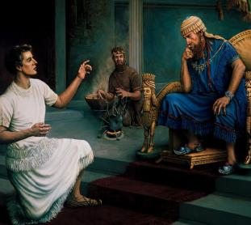
To Libby June 30/20
Before starting chapter 4, I sort of planned to do slides 22-35 of the 1st Daniel PPT (#1 of 8 … 13 slides) and then …
Go straight into this PPT.
Only slides 10 & 11 would be “another review” but because there are ONLY 2 slides, and they actually make the transition to slide 12, might be best to leave them here.
There are 7 key points to Dan 4 – this PPT addresses the first 3 of the 7 points. (about 57 slides)
Total slides before chapter 4 would be about 70.
Part 2 = 45 slides
Part 3 = 55 slides
If you can do parts 2 & 3 in one session the week after, then you’ll be more than ready to begin chapter 4 and breeze through it. Charlene
Note: No more PPTs until ready to begin chapter 7.
Then we’ll go back to Dan #1 of 8 and pick up slides 26-57 is all (the rest apply to Revelation).
Then do Chapters 8-end of ch 11 and no more PPTs till Dan 12:1. That will be quite a ways down the line.
#3 Declaring the END
From the Beginning
Daniel 4
Part 1 [of 3]
Understanding Literal Language
By: Charlene Fortsch
Notes:
Did you have time to do your Homework? Did you find the “divine interpreter” in this vision?
Well, Daniel chapter 4 may not be what you think it is!
In the next 3 sessions, we’re going to be looking at new keys that have been given to unlock the prophetic timeframe of Dan 12.
I promised you there was more, right?
Let’s have a word of prayer before we begin ...

Slide 4

A Word of Prayer
Notes:
Father as we come before you today – each and every one of us, including those that are dear and far – we petition once again that your presence will enlighten our understanding of yet another new set of concepts from the pen of Daniel.
Again, anoint our eyes, ears and understanding to your truths.
Fill our cups to the brim so we have many things to share.
We pray in your son’s name, AMEN!

Slide 5

“Declaring the end from the beginning ...”
Isa 46:9, 10 Remember the former things of old: for I am Yahuah, and there is none else ...
10 Declaring the end from the beginning, and from ancient times the things that are not yet done, saying, My counsel shall stand, and I will do all my pleasure:
Notes:
Perhaps you are wondering how Dan chapter 4 declares anything about how Dan 12 ends.
Before we delve into a new part of our study, let’s read our text together:
-- [read]
Now, let’s see how this works.

Slide 6

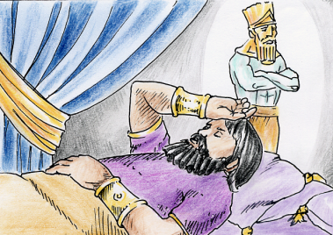
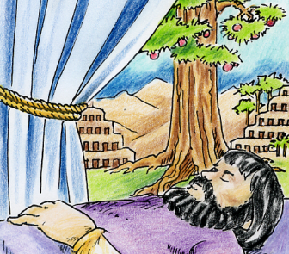
King Nebuchadnezzar’s 2 Visions
Notes:
Out of the 5 visions in Daniel’s book, two of them were given to King Neb.
I think you all know the king’s first vision is found in chapter 2.
Today, we are going to look at the king’s 2nd vision …

Slide 7
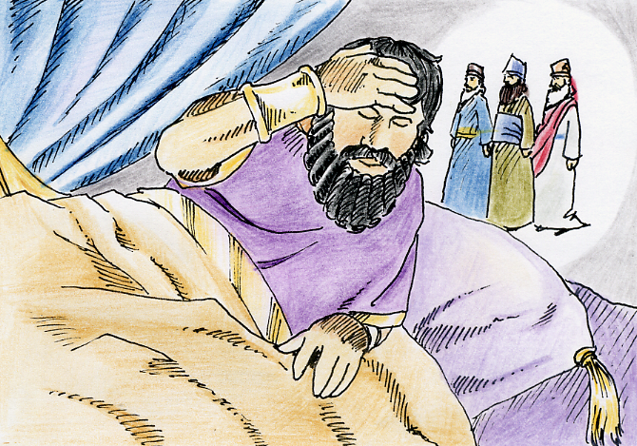
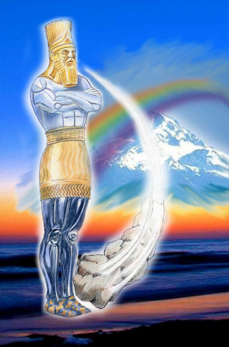


Daniel 2 ~ The King’s 1st Vision
Could not remember the vision
The vision needed an interpreter for the Image of Metals and Clay
Chaldeans failed the test
A death decree enacted
Daniel was the appointed man
Vision had to do with events surrounding Yah’s people
No timelines included
Very simple vision
Notes:
In Dan 2 the king simply … Could not remember his vision --
Obviously the king needed some help!
0c The king trusted that his magicians could tell him what the dream was AND interpret it … but the Chaldeans failed the test when they said to the king: tell us the dream and we’ll give you the interpretation!
1c ah, well, the king became very angry with that answer, and as a result A death decree was enacted immediately.
2c God has already planned that Daniel was the appointed man for this emergency … He was divinely commissioned to give the heavenly interpretation and calm everything down which – as you may recall -- saved all in the king’s court from the death decree.
3c This Vision had to do with events surrounding God’s people.45c there are No timelines included here.
This is a Very simple vision … as well as the prophecy for all succeeding visions.
As you further your studies in prophecy, you’ll see just how important this vision really is!

Slide 8


Daniel 4 ~ The King’s 2nd Vision
Author: King Nebuchadnezzar
The king remembers his dream
Huge tree
A Divine Decree instead of
a Death Decree
Vision had to do with events surrounding only the king
Very simple vision
Timeline of seven years
Needed an interpreter as the Chaldeans failed again!
Daniel was the appointed man!
Notes:
Now, let’s compare the 1st vision to the king’s 2nd vision …
-- It’s interesting too, that this chapter was written by the king himself. This time …
1c The king remembered every detail of his dream
-- It was definitely about a huge, huge tree
2c Instead of a death decree for the king’s court, there was a Divine Decree issued instead
-- This Vision had to do with events surrounding only the king
3c And … it’s a very simple vision, but with one extra detail … that being …
-- it has a Timeline of seven years. In fact, it’s the first vision in Daniel’s book that records a timeline.
4c The Chaldeans failed again when they were asked to interpret the dream … even though this time the king told them every detail of the dream! Their excuses did not impress the king.
-- But the king remembered that Daniel helped him out the first time, and so again, Daniel was God’s appointed man! Twice! … Daniel was used to teach the king of the true creator God.

Slide 9

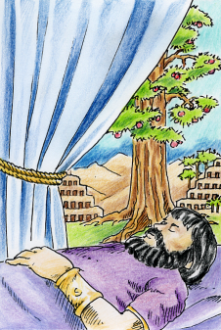
Why Was The 2nd Dream Remembered?
The Image
Given as a “idol word picture” to the king.
The dream was so different, it could not be recalled.
A Divine interpretation is given to Daniel.
The Tree
Given as an “ordinary word picture” to the king.
The king had no difficulty recalling every detail of the dream.
Daniel is called to give the interpretation.
Symbolic!
?
?
Symbolic
or
Literal?
Notes:
Let’s take a closer look at these two dreams …
The Image in Daniel 2 was given as an ‘idol word picture’ to the king. The king was “into” idol worship, that may have been the reason was he was so impressed the dream was important …
… even though he could not recall the dream.
A divine interpretation was given to Daniel …
… for this symbolic dream.
1c But why was the king able to remember the 2nd dream?
Well, this vision was given in an “ordinary word picture”
He could recall every detail of the dream, since everything related to something he already knew about.
As before, Daniel took the Chaldeans place of giving the interpretation.
2c But the question still remains …
-- Is the dream written with symbols, or is it written in literal language, without symbols?

Slide 10
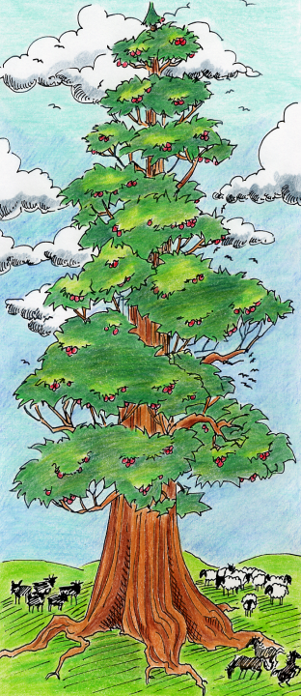
Does the
vision of
"The Tree"
follow the
"Structural
Components"
given in
Daniel 2?
Yes
Notes:
And, the other important question is …
Does this vision of “The Tree” follow the structural components given in Daniel 2?
Well, I’m here to tell you ~
1c The answer is “yes” – let’s just do a little review …

Slide 11
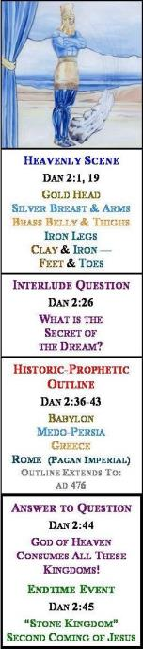
Thumbnail Structure
For Daniel 2
Forward
Progressive
Movement
Heavenly Scene
REVIEW
Interlude
Question
1. Verses
2. Kingdoms
3. Dates
Historic-Prophetic
Outline
The Pattern
Is Simple!
Answer to
Question
Endtime Event
Notes:
Let’s just begin with a short review of the Dan 2 thumbnail taken from his structure chart. By now you should all know how this works .. But just in case there is someone new here, this is what happens --
1c Every vision begins with the Heavenly Scene – that’s a good place to start isn’t it?
2c Following that, there is an interlude question that arise about what was seen in the vision. Remember, we called this interlude an “interruption” – because it “comes between” the actual vision, and the explanation of the vision.
3c Following the Interlude is the historic prophetic outline. This is the portion of the vision chapter where Daniel gives the interpretation for the Heavenly Scene – which is always an interesting part.
4c Then the Answer to the Interlude Question follows immediately – this happens in every single vision.
5c And, of course, at the very end Daniel concludes with the Endtime event, as to be expected.
6c Remember all the different ways we found the Forward Progressive Movement?
-- Verses move forward
-- Kingdoms move forward
-- Dates move forward, etc.
-- It’s a very simple pattern …
Now, let’s compare this to Daniel 4 … and see if it’s the same.

Slide 12
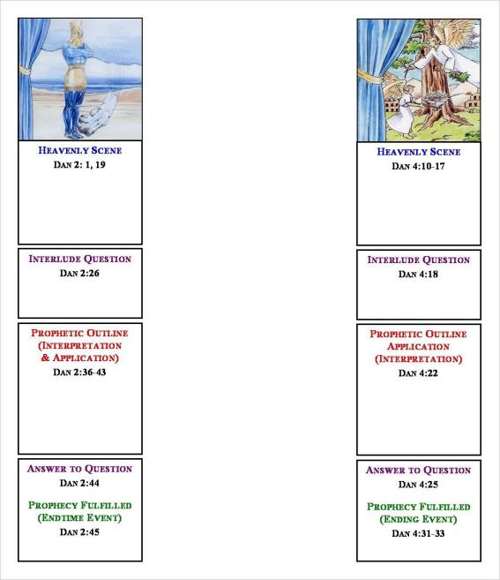
Daniel 4 also follows the same structural pattern.
The king relayed the vision from the Heavenly Scene.
This is followed by an Interlude Question.
Daniel explains the vision in the Outline portion.
Interlude Answer follows.
The prophetic vision is fulfilled.
Forward
Progressive
Movement
Dan 2
Dan 4
Daniel 7
Daniel 8 &
Daniel 10-12
Notes:
Notice here the two thumbnails – Dan 2 on the left, and Dan 4 on the right.
We’re going to find that in Daniel 4, the identical pattern of Forward Progressive movement is evident.
1c
Heavenly Scene given to the king.
Interlude question follows.
Outline – gives the interpretation
Answer to Interlude Question about the heavenly scene.
Endtime event at the END where it’s supposed to be.
Remember I told you the pattern was simple?
2c And, it’s the same pattern in Dan 7, Dan 8 and the last vision found in Dan 10-12.

Slide 13
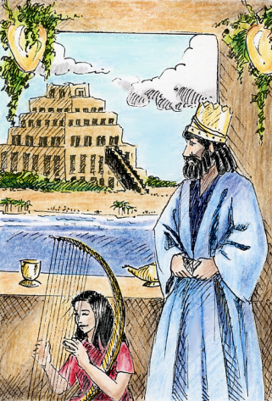
Daniel 4 ~ The Traditional Emphasis: Humbling The King
1. Conflict is between the pagan king’s pride which is arrayed against Divine Sovereignty.
Vs 30:
2. Yahuah wins as the king is turned out to eat grass, until at last the king gives Yah honor!
"Is not this Great Babylon
that I have built?"
Vs 37:
"... the King of heaven ...
He is able to abase."
Notes:
In chapters 1-3-5 & 6 we have 4 story chapters – and each of them have a traditional emphasis with patterns that will repeat at the end of time. Well, this chapter also has a traditional emphasis as well. Most say the traditional emphasis relates to the fact that King Neb “had to be humbled.” He was just too proud for his own good! But, let’s look first at the “traditional” conflict and resolution in this chapter …
1c Yes indeed, The conflict in this vision chapter is between the pagan king’s pride which was definitely arrayed against God. He had forgotten just “who” had given him this large dominion to begin with.
2c Verse 30 records the king’s words: “is not this great Babylon that I have built?”
3c In the end, God wins as the king is turned out to eat grass in the pasture UNTIL at last he gives God honor!
-- Even King Nebuchadnezzar admitted in vs 37: “… the king of heaven … he is able to abase.”
… Although this traditional emphasis has some really good practical lessons for us today, there is a special part of this chapter that connects to Revelation. Do you know what could it be?

Slide 14
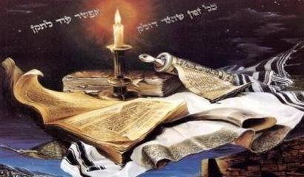
Concepts in Daniel 4 Provide
Connecting Principles For All
Timelines in Daniel and Revelation
Where are we
in the prophetic
"Stream of Time?"
Timelines!
?
14
Notes:
Timelines! The answer is timelines, and … Timelines are always exciting! But, If you don’t know how to manage timelines, prophecy can be frustrating. All timelines are meant to tell the reader where …
1c … prophecy is in the stream of time. There are many types of timelines, but how can we tell the difference. Do timelines have rules? Do we have to know the rules? Why?
And, the ultimate question,
2c … will this information affect my salvation? Definitely not! How we understand prophetic timelines has nothing to do with anyone’s salvation, but they have everything to do with understanding the timing of prophetic events in the past and future – including those in Revelation.
3c That’s why we want to look and see how D & R are connected with prophetic timelines & most people want to understand them at the same time.

Slide 15
Understanding Daniel and Revelation Timelines Through Concepts in Daniel 4
Timelines in Daniel
1. Dan 4: 7 years
2. Dan 7: ‘1260’
3. Dan 8: ‘2300’
4. Dan 9: 70 wks, 69 wks, 62 wks, 7 wks, 1 wk, & (2) ½ wk
5. Dan 12: ‘1260’ ‘1290’ & ‘1335’ days
Timelines in Revelation
1. Rev 2: 10 days
2. Rev 8: about ½ hour
3. Rev 9: (2) 5 months
4. Rev 11: 42 months; ‘1260’; 3½ days
5. Rev 12: (2) ‘1260s’
6. Rev 13: 42 months
7. Rev 17: (2) ‘1 hour’
8. Rev 18: One day & (Three) ‘1 hour’
9. Rev 20: 1000 years
Revelation
Timelines
Total: 17
Notes:
Maybe this is just a really good place to do a brief comparison of the timelines that can be found in Dan & Rev. Of course, you already know that.
1c Dan 4 has the first timeline of 7 years and we’re going to be looking at that in great detail today.
Dan 7 has a timeline that we’ll call the 1260 -- we’ll study that a little bit more later on in the next power point.
Then Dan 8 introduces a longer timeline, noted as the 2300 days.
Dan 9 has many timelines -- all of them are very, very interesting.
Then there’s Dan 12 which has another 3 exciting timelines of 1260, 1290 & 1335 days – and they’re all packed together in 6 short verses.
Now, what about Revelation, well, let’s see:
2c Rev 2: one timeline of 10 days
Rev 8: has one timeline of “about the space of ½ hour.”
In Rev 9 you will find it has two 5 month timelines that are very interesting.
Rev 11 has three timelines: a 42 months; a 1260; and a short one of only 3½ days.
Rev 12 has two timelines – both of them are 1260s.
Rev 13 has one timeline – of 42 months --
Then in Rev 17 we find two 1 hour timelines & everyone wants to know what these mean!
The chapter of Rev 18 has 4 timelines: one timeline is described as ‘one day;’ and there are three ‘one hour’ timelines as well.
And, Rev 20 has the longest timeline in Revelation. It’s called 1000 years and is mentioned 6 times in that one chapter alone.
3c In total, Revelation alone mentions 17 timelines, and I submit to you today, most of them are waiting for a future fulfillment still!!! (even tho some have tried to fit many of these timelines into the fulfilled prophecies of the historical past. Now … With that many timelines given in prophecy, surely they must play an important part in the near future -- don’t you think?

Slide 16

Timelines Are A Special Light
Do you know
how to work
with these
timelines?
Daniel 4 is
THE authority
on timelines!
Notes:
Oh yes! Timelines are a special light in prophecy.
They “light our path” through each important event, right up to the end of time.
The Question is:
1c Do you know how to work with all of these timelines?
If not, then …
you’ll find that Daniel is THE authority on timelines, and his work in this chapter is extremely important.
If anyone can help us, Daniel can!
Remember, Timelines have a special light …

Slide 17


Epilogue Timelines Of Daniel 12
1260
1290
Daniel
has the
ultimate
authority!
1335
Notes:
Three timelines are mentioned in Daniel’s Epilogue ~ the ending of his prophetic Book.
The explanation of these timelines has been, and still is, very controversial.
1c In “man’s eyes” this is a dilemma – because a lot of people don’t know what to do with these timelines!
However, Daniel (the original prophet) supplies his reader with clear instruction for understanding ALL timelines, including those in his Epilogue and Revelation.

Slide 18

Is Daniel 4 a ...
Symbolic
Vision?
Literal
Vision?
Notes:
Now … we know the vision in Daniel 2 reveals a Symbolic Image.
1c But in Dan 4, the tricky question must be asked:
Is the vision of Daniel 4 – a symbolic vision? or … literal vision?
That’s what we’re going to study today …

Slide 19

7 Main Points For Understanding
Prophetic Timelines
1. The use of symbols, compared to the use of metaphors and similes.
2. The distinction between symbolic language and literal language ~ how to really know the language of a vision.
3. The distinction between “interpretation” of a vision and the “application” of a vision.
4. Understanding the terms: “Prophetic Terminology”
and “Prophetic Time.”
5. The “Repetition of Prophecy” and its consequences.
6. The Theologian’s Argument and the Sneaky Switch!
7. How prophetic timelines
begin and end.
Notes:
In order to understand how to work with timelines, first we have to find out whether Daniel 4 is a symbolic vision, or a literal vision.
Today, we are going to examine seven important points ~ EVERY single point has something to do with questions around timelines found in Daniel & Revelation.
1c First, we’re going to define and describe the use of metaphors and similes.
2c Secondly, we will learn the difference between symbolic language and literal language and how to really know the language of a vision.
3c The third point may be a little more difficult, as we look at the terms interpretation and application. It’s important too.
4c This 4th point is really important as we discover that ‘prophetic terminology’ is NOT the same as ‘prophetic time.’
5c In the 5th point, we’re going to look at the ‘repetition of prophecy’ and what the consequences are. I think this section will be very interesting for you.
6c And, the 6th point is going to expose the theologian’s argument and what I call the sneaky switch – I’m sure you’ll be surprised to find out what’s been happening.
7c And, in the last point, we’ll look at how timelines begin and end – do all of them follow a pattern? Should they follow a pattern? What do you think?
In the end … I assure you, Daniel 4 will clear the confusion on calculation of timelines when we give very careful consideration to each of these 7 areas.
Now, let’s see how Neb describes the tree in his dream.

Slide 20

A Description of
“The Tree”
1. Great, strong tree; reached to the heavens
2. The tree could be seen by everyone
3. Fair leaves; much fruit; food for all
4. Shade for the beasts; nests for the birds
Notes:
Here’s a description of the tree from Neb. Dream …
#1 It was a great, strong tree, that to him reached clear into the heavens.
#2 Everyone could see this tree from long distances …
#3 It was a beautiful tree with fair leaves, much fruit and plenty of food for everyone.
#4 There was shade and shelter for the beasts of the field, and nests for the birds.
Let’s continue …

Slide 21
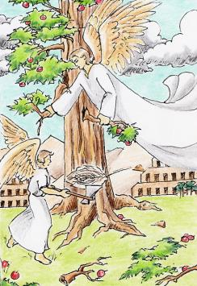
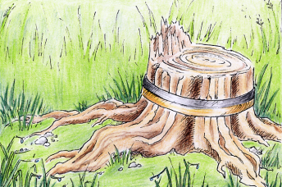
5. A watcher hewed down the tree
6. Branches cut off; leaves shaken off; fruit scatters
7. Beasts and birds flee from the tree
8. Tree stump is bound with iron and brass
9. The tree is bound for seven years.
Symbolic
Language?
Notes:
#5 As the king continues to describe the action, he told of a holy watcher that came and hewed down the tree
#6 Then the branches were cut off; the leaves shaken to the ground, scattering all the fruit.
#7 As a result, the beasts and birds fled – being very frightened
#8 After that, all that was left was a stump -- which was bound with iron and brass …
#9 … for a total of 7 years.
1c -- Does any of this sound like symbolic language to you?

Slide 22
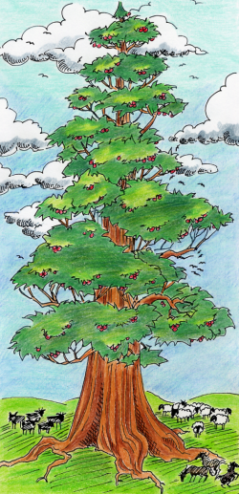
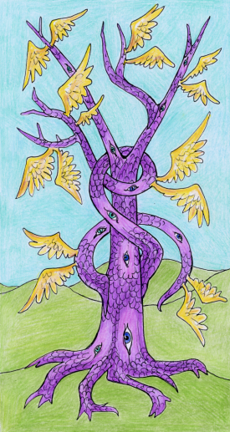
Comparison of 2 Different Trees
Daniel 4 Tree
Symbolic Tree
Notes:
Next, let’s do a comparison of 2 different trees …
This is a picture of the tree described in Daniel 4.
1c Now, here’s a picture of a tree that would be considered a -- symbolic tree. Would you not agree?
In this seminar, Daniel will demonstrate whether the tree of the king’s dream is a symbolic tree or not.

Slide 23
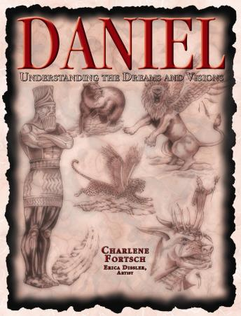

Prophetic Keys
Prophecy is an exact science
Exact Sciences follow rules
Hermeneutics (fancy term)
Daniel Book uses the term “Prophetic Key”
30 Prophetic Keys are given in the Daniel Book
New Prophetic Keys?
Notes:
Before we begin with the first of our 7 points, I just want to tell you something about prophecy in general.
Prophecy is an exact science just like Math, Chemistry and Physics.
All exact sciences follow rules. Remember your algebra classes?
Prophecy must follow rules as well.
The fancy name for these rules is the word Hermeneutics.
1c I’ll be using the term Prophetic Key – a “key” that will unlock understanding.
I’ve listed 30 Prophetic Keys, or Prophetic rules in the Daniel book, and they are numbered. [like #17: give example]
They are the basic rules.
Any new prophetic keys? Yes there are – and I’ll be reviewing that today – we’ve already covered it in the last presentations.
Now, we’re ready to look at point #1.

Slide 24

Understanding Timelines
1) Similes and Metaphors
Prophetic Key #21a, #21b
Literal language MAY use “figures of speech” such as:
a. Similes
b. Metaphors
Notes:
The first part we are going to look at is the difference between similes and metaphors.
We need to explain these terms with a very brief English lesson …
1c Prophetic Keys 21a and 21b are really important. Basically they say this:
Literal language MAY use ‘figures of speech’ such as:
a) similes
b) Metaphors
Did you know that?
Let’s get started on understanding these terms

Slide 25
Prophetic Key #21a: Similes
Similes are “figures of speech” in which two essentially “unlike” things are compared. Similes are tools of language which often employ the words, “like” or “as” using a story as an illustration.
Examples from Rev 9:
locusts were like horses
[locust’s] hair as the hair of women
[locust’s] tails like unto scorpions
Literal
Language
Notes:
Let’s take a look at similes first …
-- Here’s the definition: Similes are ‘figures of speech’ in which two essentially “unlike” things are compared. Similes are tools of language which often employ the words, “like” or “as” using a story as an illustration.
1c Here’s a few examples from Rev 9:7-10 …
locusts were LIKE horses
locust’s hair AS the hair of women
locust’s tails LIKE unto scorpions
Do you see any terms or language here that describes something we have not seen on this earth?
No, there isn’t – we have locusts, horses, women’s hair, tails and scorpions, don’t we?
2c Believe it or not, this is literal language – not symbolic language.

Slide 26


Prophetic Key #21b: Metaphors
A Metaphor is a word or phrase denoting an idea which represents something else.
"He sure was a bear this
morning at the breakfast table!"
"a bear?"
"really grumpy?"
Notes:
Now, let’s look at what a Metaphor is by definition …
--A Metaphor is a word or phrase denoting an idea which represents something else.
-- For example:
1c sometimes for a “grumpy spouse” someone might say: “He sure was a bear this morning at the breakfast table.
Does that mean the spouse was really a
2c “bear” or -- just “really grumpy?”
Yes, we understand, he was just really grumpy!
Why? Because ... It’s a metaphor!

Slide 27
Prophetic Key #21b: Metaphors
A Metaphor is a word or phrase denoting an idea which represents something else.
Example from Rev 9:1
“I saw a star fall from heaven” denotes a “created being” ~ not a real star.
Other examples:
I smell a rat …
There’s a monkey in the woodpile.
Something smells fishy …
Literal
Language
Notes:
Now, let’s look at some examples from Rev 9:1 --
1c I saw a STAR fall from heaven – this denotes a “created being” – not a real star.
2c Other examples … that we may hear everyday are:
-- I smell a rat …
There’s a monkey in the woodpile …
or … something smells fishy … I’m sure you’ve heard some of these expressions.
-- There usually isn’t a real rat, monkey or fish in the thought.
It may not sound like it …
3c … but this is literal language.

Slide 28
Daniel 4 Examples of
Similes and Metaphors
20 The tree that thou sawest, which grew, and was strong, whose height reached unto the heaven, and the sight thereof to all the earth;
21 Whose leaves were fair, and the fruit thereof much, and in it was meat for all ...
22 It is thou, O king …
Daniel’s Metaphor:
“The tree that thou sawest … It is thou, O king.”
Simile Examples:
1. You, O king, are like that great tree.
2. You, O king, are as that great tree.
In literal language
the king is compared
to the great tree.
Notes:
Now, let’s look at examples of similes and metaphors in Daniel 4 by reading these selected verses:
20 The tree that thou sawest, which grew, and was strong, whose height reached unto the heaven, and the sight thereof to all the earth;
21 Whose leaves were fair, and the fruit thereof much, and in it was meat for all ...
22 It is thou, O king …
1c Daniel’s using a Metaphor when he says:
-- “the tree that thou sawest … it is thou, O king.” [this is a direct application, by the way.]
2c Or -- Daniel cold have used similes as well by saying:
-- 1. You, O king, are LIKE that great tree. Or …
-- 2. You, O king, are AS that great tree.
3c What Daniel is doing here is using literal language when he compares the king to the great tree.

Slide 29
Conclusion on
Similes and Metaphors
Similes compare: by using words such as “like” or “as.”
Metaphors compare: by using phrases.
Prophetic Key #19
Daniel 4 is written in literal language. Therefore it is to be interpreted literally.
Literal Language often uses
Similes or Metaphors.
The Language is 100% Literal!
Notes:
Are you ready to conclude this English lesson on similes and metaphors?
Let’s do a summary then!
Similes are comparisons by using words such as LIKE or AS. Metaphors are comparisons by USING PHRASES.
1c Remember: Literal language OFTEN uses similes or metaphors. Rev 9 is a perfect example of this.
Compare Rev 16 and see what’s there ...
2c And do remember this prophetic key #19: That Daniel 4 is written in completely literal language. Therefore it is to be interpreted literally.
3c What is the conclusion for point #1? The language of this vision is 100% literal!
Note: There is literal language in symbolic visions as well to carry the thoughts of the symbols.
But, when there is ONLY literal language, THEN we know everything about the vision must be interpreted literally.

Slide 30
Understanding Timelines
2) Symbolic Language or
Literal Language
Prophetic Key #18
The Bible is to be understood in its most obvious (or literal) sense, UNLESS a figure or symbol is employed.
Notes:
OK, we’re ready to look at point #2 and how to understand timelines whether they are couched in symbolic language or literal language.
There’s a vast difference between these two terms.
1c First, let’s look at a prophetic rule that is so important. “The Bible is to be understood in its most obvious (or literal) sense, UNLESS a figure or symbol is employed.
Remember, a symbol is a word picture of something that we don’t normally see on this earth.
The Bible has to give us a start on interpreting symbols –
... once that has been done, often history can interpret the next set of symbols.

Slide 31

If The King Saw A Symbolic Tree
The purple trunk would have scales and eyes
Unusual branch formation
Wings instead of leaves
A tree such as this would have been considered “symbolic.”
In that case:
Daniel would have needed Divine interpretation through another vision or dream.
Gabriel would have been commissioned to give Daniel understanding
of this tree.
Maybe:
Symbolic Tree
Notes:
If the king really did dream of a symbolic tree, maybe it would have looked like this:
1c Maybe the trunk would have been purple with scales and eyes instead of bark.
Maybe the branches would have had an unusual formation
Could the tree have had wings instead of leaves?
Would you agree, that a tree described in this way would have been considered symbolic?
2c In that case: 1) Daniel would have needed a divine interpreter bringing him the interpretation through a personal vision or dream.
Or … Gabriel would have been commissioned to give Daniel understanding of a symbolic tree such as this.
That leads us to the next question …

Slide 32

Question: Does Daniel Have An
Interpreter For This Vision?
NO! There is no interpreter given to Daniel for this vision.
Rule #1:
For a Symbolic Vision,
Daniel needs an interpreter.
Rule #2:
For a Literal Vision,
Daniel does not need an interpreter!
Notes:
If you had a chance to read all the verses in Daniel 4, I wonder if you can answer this question?
Does Daniel have an interpreter for this vision?
1c … The answer is NO … there is no interpreter given to Daniel for this vision. Let’s remember 2 rules …
2c … Rule #1: For a symbolic vision, Daniel NEEDS an interpreter.
3c … Rule #2: For a literal vision, Daniel DOES NOT NEED an interpreter.
In the next few slides maybe we can figure out why …

Slide 33
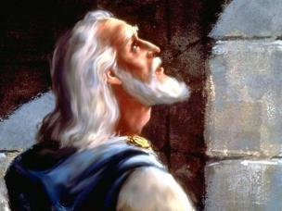
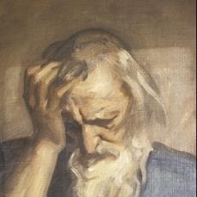
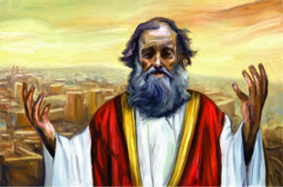
Three Contemporary Prophets
Daniel
Exiled in 606 BC – Daniel was Heaven’s ambassador to the court of the king – to make known Yahuah’s divine will and secure cooperation on behalf of His people.
Ezekiel
Exiled to Babylon in 597 BC. He had the same message as Jeremiah, but for those already in Babylonian captivity.
Jeremiah
Remained with the Jews who were left in Judea. He eventually ended up in Egypt.
"Accept your condition of exile. You must
submit to the king of Babylon for 70 years."
Notes:
Daniel, Ezekiel & Jeremiah were commissioned to reveal Heaven’s purpose to men and to elicit cooperation with it. This divine plan was in the “best interest” of God’s people, even if they didn’t think so!
1c Daniel … was: Exiled to Babylon in 606 BC – He was Heaven’s ordained ambassador to the court of the king – to make known God’s divine will – and -- secure cooperation on behalf of God’s people. It was quite a huge task!
2c Ezekiel … was: Exiled to Babylon in 597 BC – almost 10 years after Daniel. He had the same message as Jeremiah, but for those already in Babylonian captivity.
3c Jeremiah, known as the weeping prophet … Remained with the Jews who were left in Judea. Remember, he eventually ended up in Egypt – against his will and God’s will. All 3 of these prophets had the same message…
4c … “Accept your condition of exile. You must submit to the king of Babylon for 70 years.”
And remember: God’s people had to contend with false prophets that said they would never be carried off to Babylon. We may have to contend with similar events in the near future.

Slide 34
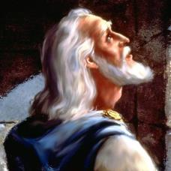
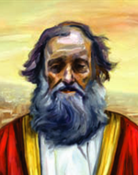
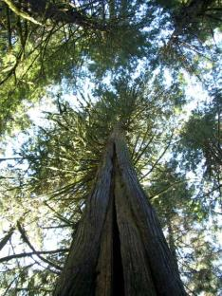

Daniel and Ezekiel Were Contemporaries in Babylon
Facts:
606 BC: Daniel exiled to Babylon
597 BC: Ezekiel exiled to Babylon
594 BC: Eze 17 written
588 BC: Eze 31 & 32 written
569 BC: Nebuchadnezzar’s
dream of the tree
Daniel had access to Ezekiel’s prophecies
about 20 years in advance of this dream.
Notes:
Now, Daniel & Ezekiel were Contemporaries in Babylon.
If we put some facts in order, this will assist us in understanding this vision …
We just mentioned that Daniel exiled in 606 BC
Ezekiel followed in 597 BC
1c Eze 17 was written in approx 594 BC (this chapter compares King Jehoichin to the “top of a cedar tree.”)
Eze 31-32 was written approx 588 BC (here Pharaoh of Egypt is compared to a “cedar tree in Lebanon.”)
2c 569 BC: is the approx date of Neb dream of the tree. So, you can see that …
Daniel had access to Ezekiel’s prophecies about 20 years in advance of the king Neb’s dream.
But, what does that mean? Let’s take a closer look at Ezekiel’s prophecies.

Slide 35
Ezekiel’s Prophecies of Other “Trees”
Prophetic Fact: Assyria had at one time surpassed Egypt in power and prominence. But, it had not been able to escape divine destruction.
These chapters warn the Pharaoh of Egypt that his fate would be the same as the Assyrian nation, IF he did not change his ways.
Eze 31:18; 32:11
Yet you too [Pharaoh], will be brought down with the trees … to the earth below; you will lie among … those killed by the sword. This is what our Sovereign Yahuah says [to Pharaoh]: “The sword of the king of Babylon will come against you.”
Notes:
Many years previous to the Babylonian captivity, Ezekiel was instructed to give prophecies concerning Assyria and Egypt. These two nations were compared to “trees.”
Let’s look at some prophetic facts:
1c First prophetic Fact: Assyria had at one time surpassed Egypt in power and prominence. But, it had not been able to escape divine destruction. Remember Sennacherib, the Assyrian leader, not only reproached and blasphemed God, but he also threatened Israel with destruction. At that point it was only a short time when the angel of the Lord struck dead 185,000 men of his army in one night. He ended up returning with a shamed face to his own land. 2 Kings 19:35; 2 Chron 32:21 GC 512 (Nov 11/10)
2c Ezekiel’s chapters warn the Pharaoh of Egypt that his fate would be the same as the Assyrian nation, if he did not change his ways.
3c YES -- Many decades before, Ezekiel had already predicted the fate of Egypt’s Pharaoh, comparing him to a tree. Let’s read what he wrote: Yet you too [Pharaoh], will be brought down with the trees … to the earth below; you will lie among … those killed by the sword. This is what the Sovereign Lord says [to Pharaoh]: “The sword of the king of Babylon will come against you.”

Slide 36
Ezekiel’s Prophecies f Other “Trees”
Prophetic Fact: Assyria had at one time surpassed Egypt in power and prominence. But, it had not been able to escape divine destruction.
These chapters warn the Pharaoh of Egypt that his fate would be the same as the Assyrian nation, IF he did not change his ways.
Eze 31:18, 32:11
Yet you too [Pharaoh], will be brought down with the trees … to the earth below; you will lie among … those killed by the sword. This is what our Sovereign Yahuah says [to Pharaoh]: “The sword of the king of Babylon will come against you.”
Prophetic Warning:
Pharaoh was reminded of Assyria’s fate. IF Egypt does not turn from its wicked ways, judgment will come against her, just as it had against Assyria.
Prophetic Fulfillment:
Once Egypt came under Babylonian rule, she never again achieved her former glorious status in the world.
Daniel saw this fulfillment!
Notes:
What was Ezekiel’s prophetic warning: Pharaoh was reminded of Assyria’s fate. IF Egypt does not turn from its wicked ways, judgment will come against her, just as it had against Assyria.
1c And, what was the historical fulfillment: Once Egypt came under Babylonian rule, she never achieved her former glorious status in the world.
--The description of Ezekiel’s prophetic tree’s is very similar to the vision given to King Nebuchadnezzar in Daniel 4, isn’t it?
2c Daniel witnessed this fulfillment of prophecy.
Is it any wonder he knew exactly what King Nebuchadnezzar’s dream meant?

Slide 37
Daniel already had access to Ezekiel’s prophecies for over 20 years.
The fulfillment of Ezekiel’s prophecies also provided the interpretation for the dream of King Nebuchadnezzar.
He immediately knew what the dream meant.
However: “Daniel … was astonied for one hour, and his thoughts troubled him.” [vs19]
“astonied” – Strong’s H8074; to be stunned; amazed; overwhelmed.
Remember ...
Notes:
Remember – at the time King Nebuchadnezzar had this dream of the tree being cut down: Daniel already had access to Ezekiel’s prophecies for over 20 years!
1c The fulfillment of Ezekiel’s prophecies also provided the interpretation for the dream of King Nebuchadnezzar.
2c Daniel immediately knew what the dream meant.
3c However: Daniel … was astonished for one hour, and his thoughts troubled him. – we find that in Dan 4:19 …
4c The Strong’s definition of “astonied” is “to be stunned; amazed; overwhelmed.”
Daniel knew very well what the dream meant, he just didn’t want to be the one to give the bad news to the king. Would you?

Slide 38
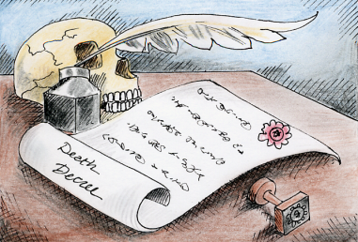
Daniel’s Delay For One Hour ~ Why?
Daniel was fixed in thought and profound silence before the king.
Daniel immediately knew the fearful consequences of this dream concerning the king.
Revealing bad news could end in a death decree.
The king assured Daniel of his safety.
With utmost courtesy and respect to the king, Daniel replied …
"My lord, the dream
be to them that
hate thee, and the
interpretation
to thine enemies."
Notes:
When the king relayed the dream, why was Daniel was so stunned for one literal hour?
1c We read: He was so fixed in thought and profound silence about the meaning of this dream, UNTIL the king addressed him.
Because Daniel was well acquainted with Ezekiel’s prophecies (comparing kings and pharaoh’s to trees), he immediately knew the fearful consequences of this dream concerning King Neb.
2c Daniel also knew the danger of revealing bad news to the king ~ another death decree. (In those days you just didn’t do that!)
The king assured Daniel he was safe, no matter what, because by this time he had a special regard for this captive Jew.
3c Out of courtesy and respect to the king, Daniel replied … “My Lord, the dream be to them that hate thee, and the interpretation to thine enemies.”
-- Now, let’s take a closer look at some of the vs in chapter 4 and see how Daniel understood the application for the king.

Slide 39
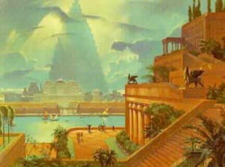
How Vs 11 Applied to the King
11a The tree grew …
Nebuchadnezzar’s kingdom was glorious; known to all ~ becoming more glorious over the years.
11b … and was strong …
As the tree was well proportioned in height, mass and foliage, so Babylon was proportioned in wealth, military strength and social status. Military strength could refer to the trunk, firmly fixed in the earth providing safety from any enemy.
11c … and the height thereof reached unto heaven …
This kingdom extended in every direction.
11d … and the sight thereof to the end of all the earth.
This kingdom was so conspicuous that it was known everywhere, meaning Nebuchadnezzar was a sovereign that had universal sway; all men would be subject to him.
Notes:
Let’s start at verse 11 to see how it is applied to King Nebuchadnezzar: We’ll look at a phrase at a time …
--11a The tree grew … meaning …
1c Nebuchadnezzar’s kingdom was glorious; known to all ~ becoming more glorious over the years. Do any of you recall the hanging gardens that he built, considered to be one of the 7 wonders of the world?
--The next phrase tell us [11b] … [and] the tree was strong …
2c As the tree was well-proportioned in height, mass and foliage, so Babylon was proportioned in wealth, military strength and social status. Military strength could refer to the trunk, firmly fixed in the earth providing safety from any enemy.
--Continuing on, the verse reads: 11c … and the height thereof reached unto heaven … meaning …
3c This kingdom extended in every direction.
--And finally the verse reads: 11d … and the sight thereof to the end of all the earth. Meaning …
4c This kingdom was so conspicuous that it was known everywhere. Nebuchadnezzar was a sovereign that had universal sway; all men would be subject to him just as the previous prophecies of Ezekiel and Jeremiah had foretold.

Slide 40
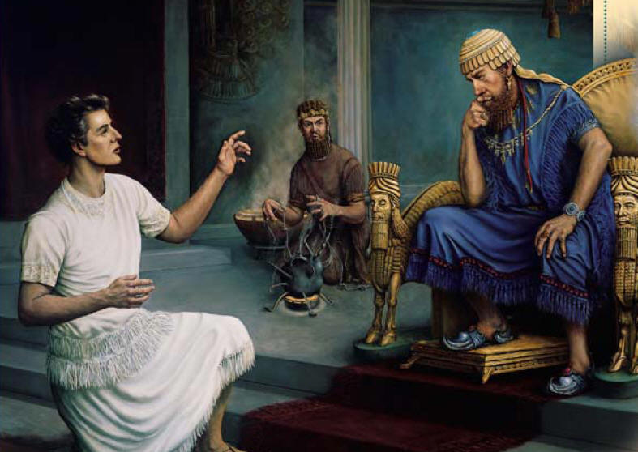
How Vs 12 Applied to the King
12a The leaves thereof were fair …
Babylon was in the prime of its growth and life; no signs of decay ~ only vigorous and healthy growth resembling a monarch in his glory.
12b … and the fruit thereof much …
Babylon was full of goodness, life and vitality.
12c … and in it was meat for all …
Food for all: This indicates the dependence of the multitudes upon the king to provide food and liberal favors.
12d … the beasts of the field had shadow under it … the fowls in the heaven dwelt in the boughs …
The shade represented the blessings of protection and peace; care for the widows, fatherless and poor.
12e … all flesh was fed of it.
The king, as the tree, was to furnish protection, shelter, and food for all the citizens.
Notes:
Verse 12 has more information about the king …
--12a The leaves thereof were fair … meaning …
1c Babylon was in the prime of its growth and life; there were no signs of decay in this kingdom ~ only vigorous and healthy growth resembling a monarch in his glory.
--12b … and the fruit thereof much …
2c Babylon was full of goodness, life and vitality. There were many benefits for all citizens.
--12c … and in it was meat for all …
3c Food for all: This indicates the dependence of the multitudes upon the king to provide food and liberal favors. It is written that Babylon had enough food supply within its walls for 7 years, and of course with the Euphrates river running through the midst of it – there was food and water for all for a long time.
--12d … the beasts of the field had shadow under it … the fowls in the heaven dwelt in the boughs …
4c The shade represented the blessings of protection and peace; care for the widows, fatherless and poor. Being known as the Golden City, Babylon had a tremendous amount of wealth. There was no difficulty to provide for everyone!
--12f … all flesh was fed of it. … meaning …
5c The king is likened to the tree. Therefore, he was to furnish protection, shelter, and food for all the citizens.

Slide 41
How Vs 13 Applied to the King
13a … and behold, a watcher and an holy one came down from heaven …
Bless Yahuah,
ye his angels,
that excel in strength,
that do his commandments,
hearkening unto
the voice of his word.
Psalm 103:20
The character of the watcher was that of a “holy one” from heaven.
Notes:
Verse 13 tells us what happens next …
13a … and behold, a watcher and an holy one came down from heaven …
1c The character of the watcher was that of a “holy one” from heaven.
2c As recorded in Ps 103:20, the Holy Watcher obeyed the word of the Lord: “Bless the Lord, ye his angels, that excell in strength, that do his commandments, hearkening unto the voice of his word.”

Slide 42

How Vs 14 Applied to the King
14a … Hew down the tree …
Divine orders are given to the “watcher” to take the king off his throne.
14b … cut off his branches, shake off his leaves, and scatter his fruit: let the beasts get away from under it, and the fowls from his branches.
The king (and kingdom) were to be utterly stripped of all glory and beauty. Calamity, humiliation and desolation were imminent. The glory of the kingdom is at stake; the subjects are at a loss without their leader.
Notes:
Verse 14 continues …
14a … Hew down the tree …
1c Divine orders are given to the “watcher” to take the king off his throne.
Why? Because the king’s pride came before the care of his subjects.
14b … cut off his branches, shake off his leaves, and scatter his fruit: let the beasts get away from under it, and the fowls from his branches.
2c The king (and kingdom) were to be utterly stripped of all glory and beauty. Calamity, humiliation and desolation were imminent. The glory of the kingdom is at stake; the subjects are at a loss without their leader.
Let’s move on to verse 15 now.

Slide 43
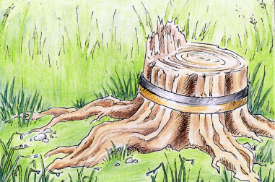
How Vs 15 Applied to the King
15a … leave the stump of his roots in the earth …
Nebuchadnezzar and his kingdom are not wholly dead. In time a new shoot will spring forth, giving life again to the kingdom. Though the king falls, vitality remains in the root of the kingdom of Babylon. The king would be restored to his reason and power.
15b … even with a band of iron and brass …
This banding is given to any valuable stump to preserve it from being dried out or plowed under.
15c … in the tender grass of the field; let it be wet with the dew of heaven …
The king would remain out of doors, excluded from the palace.
For there is hope of a tree,
if it be cut down,
that it will sprout again,
and the tender branch
will not cease.
Job 14:7
Notes:
More detail is given in verse 15: telling us to …
15a … leave the stump of his roots in the earth …
1c Nebuchadnezzar and his kingdom are not completely dead. In time a new shoot will spring forth, giving life again to the kingdom. Though the king falls, vitality remains in the root of the kingdom of Babylon. The king would be restored to his reason and power. Remember: as the Image in Dan 2 had clay in the feet and toes – the roots of this tree also find footing in the “clay of the earth.” Eventually all “root kingdoms” will subdivide and mix with the clay of the earth at the end of time.
15b … even with a band of iron and brass …
2c The banding is given to any valuable stump to preserve it from being dried out or plowed under.
What else? Well, the binding also gave hope that the stump would retain moisture to spring up again! When the last of the Babylonian kings were finally cut off, the kingdoms that followed were of Brass (Greece) and Iron, representing Rome. So, can you see how the roots of Babylon extend to the very end of time? And just another point here … Iron and Brass also connects to the bronze claws and iron teeth of the 4th beast in Daniel 7, representing Rome. Lot’s of connections to these bands of iron and brass, aren’t there?
15c … in the tender grass of the field; let it be wet with the dew of heaven … meaning …
3c The king would remain out of doors, excluded from the palace … but
… during the years, the dew of the Lord’s protection would preserve the king so that he could rule his kingdom when his heart was regenerated with a new understanding of Divine sovereignty. 4c (Word Art in Job 14:7 we read …)

Slide 44
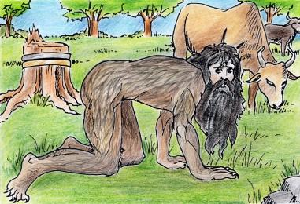
How Vs 15d-16 Applied to the King
15d … let his portion be with the beasts …
… and let the king live as the beasts do ~ in the grassy fields.
16a Let his heart be changed from man’s, and let a beast’s heart be given unto him …
The king lives contently in nature as do the beasts.
16b … let seven times pass over him.
The king will stay in this “beast like” condition until he is restored after an appointed period of time.
He causeth them to
wander in the wilderness,
where there is no way.
Psalm 107:40
Notes:
Chapter 4 continues with the detail …
15d … let his portion be with the beasts … most of us know that this meant to …
1c … and let the king live as the beasts do ~ in the grassy fields.
16a Let his heart be changed from man’s, and let a beast’s heart be given unto him … meaning …
2c The king lives contently in nature as do the beasts.
16b … let seven times pass over him.
3c The king will stay in this “beast-like” condition until he is restored after an appointed period of time.
4c What did Ps 107:40 predict: “He causeth them to wander in the wilderness, where there is no way.” Hmm… you know, sometimes God just let’s us wander in the wilderness until we wander right back to Him! He waits for us!

Slide 45
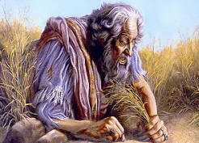

How Vs 33 Applied to the King
33a … hairs were grown like eagles’ feathers …
Just as the eagle is “king of the birds” ~ so Nebuchadnezzar was still “king of Babylon.”
Daniel 7 represents Babylon as a “lion” ~ the “king of the beasts.”
Notes:
Now, more information about the King in vs 33 … This is the last verse we’re going to look at …
33a … hairs were grown like eagles’ feathers …
1c Just as the eagle is “king of the birds” ~ so Nebuchadnezzar was still “king of Babylon.”
2c (Daniel 7 represents Babylon as a “lion” ~ the king of the beasts.) That’s just an interesting comparison, isn’t it – being king of the birds and beasts?

Slide 46
Conclusion on Daniel 4:
Symbolic Language or
Literal Language?
There is no symbolic language that would require an interpreter.
There is no interpreter sent to explain the meaning of the vision.
The king is merely compared to a great tree, as were the kings of Assyria and Egypt.
This Language is 100% Literal!
Notes:
What is the conclusion for Point #2 on Daniel 4 – What do you think? Is the vision written with symbolic language, or all literal language?
Here is the conclusion of the matter …
1c There is no symbolic language that would require an interpreter.
2c There is no interpreter sent to explain the meaning of the vision.
3c The king is merely compared to a great tree, as were the kings of Assyria and Egypt.
4c Again This vision is definitely 100% literal! That’s the same conclusion we found for point #1.

Slide 47
Understanding Timelines
3) The Difference Between
“Interpretation” and “Application”
Prophetic Key #20
Prophecy written in literal language uses APPLICATION to align historical events with Scripture.
Notes:
So, a careful study of points #1 and 2 confirmed this vision is literal. Let’s look at point #3.
Here … we are going to examine the terms interpretation and application. This is likely going to be new information for you, so I hope you can grasp the concept.
1c Prophetic Key #20 tells us … “Prophecy written in literal language uses application to align historical events with Scripture.”
Now … what in the world does that mean?

Slide 48

Understanding “Interpretation”
2 Peter 1:20
Above all, you must understand that no prophecy of Scripture came about by the prophet's own interpretation. (NIV)
Prophetic Key #16
Symbolic Interpretation is used when the prophetic word picture is of something that is not real.
“interpretation” – to explain the meaning of visions or dreams; lay open what is not understood. (Webster’s 1828)
Notes:
Let’s try to understand the term “interpretation” first.
2 Peter 1:20 tells us: Above all, you must understand that no prophecy of Scripture came about by the prophet's own interpretation. (NIV)
1c Now. Let’s look at Prophetic Key #16 to see what the rule has to say about “symbolic interpretation.” This is defined as a prophetic word picture of something that is NOT real. Well, that’s easy enough …
2c Webster’s 1828 dictionary defines “interpretation” as – to explain the meaning of visions or dreams; to lay open what is NOT understood.
So … what does that mean to you? Most definitely, Peter is telling us that the Bible will have to give the reader the starting point of the interpretation. WE cannot start it – the Bible has to. And, that’s exactly what happens in Daniel – he always gives the starting point of the interpretation. We never have to guess what it could be. Let’s look at some examples.

Slide 49
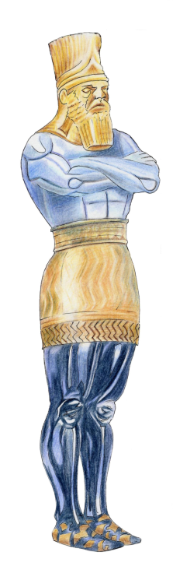
Symbolic “Interpretation” (Dan 2)
Symbol: (vs 32)
This image's head was of fine gold …
Prophetic Key #17
The Bible will be used to interpret the symbol.
Decoding the Symbol: (vs 38)
Thou [Nebuchadnezzar] art this head of gold.
Literal Application:
The gold head represents the First Kingdom called Babylon.
REVIEW
Notes:
If symbols are involved, the Bible must give us the interpretation, until the obvious meaning can be discerned from history, if possible.
1c In Dan 2, the first symbol was the head of fine gold on the image.
2c Following Prophetic Key #17, We allowed the Bible to interpret.
3c The Bible decoded the gold head for us in vs 38 when we read … “Thou [Nebuchadnezzar] art this head of gold.”
4c Then we made the historical literal application to the king and kingdom of Babylon. So in this application, the gold head represents the first kingdom called Babylon.
Those are the steps needed when symbols are present-and they always follow in that order.

Slide 50
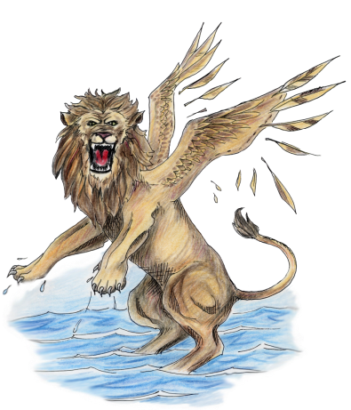
Scriptural Documentation:
1st Kingdom
Babylon
Dan 2:36-38 This is the dream; and we will tell the interpretation thereof before the king.
37 Thou, O king ... Yahuah of heaven ...
38 ... hath made thee ruler over them all. Thou art this head of gold.
?
?
?
Also see:
Jer 50:7, 17
Jer 50: 43, 44
The Bible Interprets the Prophetic Kingdoms
Notes:
In Daniel 7, the first beast is a winged lion –
1c -- representing the first kingdom of Babylon.
Daniel had given that interpretation in Daniel 1, so he doesn’t have to give it again.

Slide 51

Babylon
Scriptural Documentation:
2nd Kingdom
Medo-Persia
?
Dan 2:39a And after thee shall arise another kingdom inferior to thee ...
Dan 8:20 The ram which thou sawest having two horns are the kings of Media and Persia.
Jer 51:11 ... Yahuah hath raised up the spirit of the kings of the Medes: for his device is against Babylon, to destroy it;
?
?
The Bible Interprets the Prophetic Kingdoms
Notes:
In Daniel 8:20, the 2nd kingdom is identified as Medo-Persia by the angel Gabriel.
1c So then we know which kingdom applies to the silver chest and arms.
Also – don’t forget -- there were prophecies in Jeremiah that agree with Daniel.

Slide 52

Babylon
Scriptural Documentation:
3rd Kingdom
Medo-Persia
Dan 2:39b ... and another third kingdom of brass, which shall bear rule over all the earth.
Dan 8:21 And the rough goat is the king of Grecia: and the great horn that is between his eyes is the first king.
?
Greece
?
The Bible Interprets the Prophetic Kingdoms
Notes:
The angel Gabriel also interprets for Daniel the 3rd kingdom of Greece as the goat with a symbolic notable horn
1c – this aligns with the brass belly of the image AND history agrees.
These 1st three visions give a few examples of how the Bible interprets “symbols.”

Slide 53
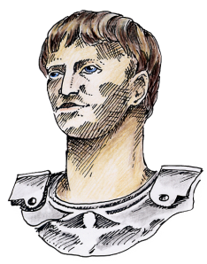
Babylon
Scriptural Documentation:
4th Kingdom
Dan 2:40 And the fourth kingdom shall be strong as iron:
Dan 11:20 Then shall stand up in his estate a raiser of taxes in the glory of the kingdom:
Luke 2:1 ... there went out a decree from [the Roman] Caesar Augustus, that all the world should be taxed.
Medo-Persia
Greece
?
Rome
Secular History is a 2nd Witness
All Prophetic Kingdoms Interpreted
Through the Bible
Notes:
In Dan 11, he described the 4th kingdom as having a “raiser of taxes” – and ...
1c ... Yes we know from the NT that this was Caesar Augustus, a Roman.
So, the Bible has given the interpretation!
And ... When we use “historical fact” – we give an application to the verses in the vision.
So ... Visions that have NO symbols –with only literal language – are different.
This is where the term “application” comes in.

Slide 54
Understanding “Application”
Prophetic Key #18
The Bible is to be understood in its most obvious (or literal) sense, UNLESS a figure or symbol is employed.
Prophetic Key #20
Literal Interpretation is used when the prophetic word picture is of something real. Literal events are given application to the “word picture.”
(Webster’s 1828)
“application” –
principles are applied
in a practical way.
Notes:
Now we need to look at the term APPLICATION.
First of all we’ll review Prophetic Key #18: The Bible is to be understood in its most obvious (or literal) sense, UNLESS a figure or symbol is employed. Remember – similes and metaphors are not the same as symbols!
1c And … Prophetic Key #20 tells us: Literal Interpretation is used when the prophetic word picture is of something real. Literal events are given application to the word-picture.
2c So, the definition of “application” from Webster’s 1828 dictionary is: principles are applied in a practical way.
That’s exactly what King Nebuchadnezzar wanted to know – how this vision applies to him in a practical way.
We know the king didn’t understand the vision, so from his point of view he needed an interpretation.

Slide 55

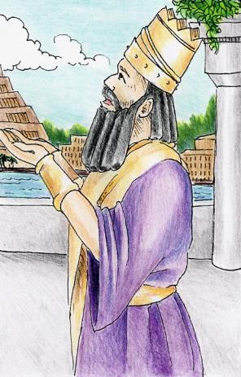
Literal Language: Easy To Work With
Metaphor: “The tree that thou sawest … It is thou, O king.”
Application
Symbolic
Interpretation
Literal Tree
Literal King
Notes:
Literal Language is also easy to work with …
If a vision is written in literal language, then there is NO “interpretation” needed from the Bible itself ~ one simply applies secular historical fact to the phrases and verses of Scripture.
1c In Dan 4 a literal tree is compared to a literal king when Daniel says:
“The tree that thou sawest … It is thou, O king.” He uses a metaphor and application of Ezekiel’s prophecies.
2c (arrow) Daniel merely compares a real tree, to a real king – just like Ezekiel did.
… The king told Daniel the dream, and Daniel gave the king
the application of how the dream applied to him.
Daniel is establishing a pattern here in Chapter 4, because he does the same thing in Outline of Dan 11 -- the ONLY other vision written with literal language – where - Historical application is aligned with the individuals and events.
3c Dan 4 does not need Symbolic Interpretation because there simply are NO symbols! It’s just that easy!

Slide 56
Daniel 4:9, 18 ~ “interpretation”
“interpretation”
Used 30 times in Daniel’s book.
Strong’s H6622; to open up
[the meaning] – or to understand
the proper “application.”
Two Examples:
Vs 9 … tell me … the interpretation [the application for me] …
Vs 18 … make known unto me the interpretation [the application for me] …
Notes:
The word “interpretation” is used all through chapter four.
In fact, it is used 30 times in Daniel’s book.
The Strong’s definition means: to open up [the meaning] – or to understand the proper “application.”
Here are 2 examples.
1c In vs 9, the kings says: … tell me … the interpretation (or – he wants to know the application that is meant for him].
Then in vs 18, he asks Daniel: … make known unto me the interpretation [again, he wants to know what the application is, and how it will affect his life.]

Slide 57
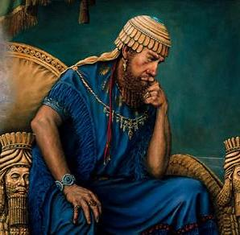
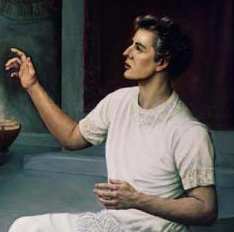
The Difference Between
King Nebuchadnezzar And Daniel
Daniel did not need to be given an interpretation. He merely made practical application to the king using the historical facts of his day
along with the prophecies.
King's
Viewpoint
The King needed an
Interpretation.
Daniel's
Viewpoint
Notes:
Daniel 4 is a literal vision BUT Scripture uses the word “interpretation” ~ when a better term would have been “application!”
So, what is the difference between King Nebuchadnezzar and Daniel?
1c From the king’s point of view – he really did need an interpretation, which Daniel gave to him.
-- From Daniel’s viewpoint – he did not need an interpretation.
Using the patterns of fulfilled prophecies from Ezekiel, he merely made practical application of a “tree” to yet another king.
He did this by using the historical facts of his day.
There was one difference though: Nebuchadnezzar was restored to his kingdom, unlike the others.

Slide 58
Summary: Daniel Knew The “Application”
Vs 19: “My lord, the dream be to them that hate thee, and the interpretation [application] thereof to thine enemies.
20 The tree that thou sawest …
22 … it is thou, O king …”
The application did not:
1. Come through a dream or vision.
2. Come from the angel Gabriel.
3. Need a symbolic interpretation.
This Vision uses Literal Language!
Notes:
Oh yes, Daniel knew how the application and how this prophecy applied to the Babylonian king … Recorded in verses 19-20 & 22 he said: “My lord, the dream be to them that hate thee, and the interpretation thereof to thine enemies. [Notice, Daniel uses the word “interpretation” when a better term for today would be application! But, he is responding in the same terminology as the king.] He goes on to say: The tree that thou sawest … it is thou O king.”
1c The application did not:
1. come through a dream or a vision.
2. It did not come from the angel Gabriel.
3. And, the application did not need a symbolic interpretation – first – like the gold head in Daniel 2 did.
Remember!! Daniel understood Ezekiel’s prophecies for the kings of Assyria and Egypt, and he would have known about the prophetic fulfillment for the Pharaoh of Egypt. He simply applied the outcome of these prophecies to King Nebuchadnezzar. No Interpreter was needed!
2c Why? Because This vision uses 100% Literal Language!
I hope you can now understand the difference between Symbolic interpretation, and literal application, as this hermeneutic is very important if you want to understand Daniel 11 and 12 correctly! The concepts are right here. Daniel made sure he established the patterns right here!!! To make it easy for you! [END of lecture.]

Slide 59


#4 Declaring the END
From the Beginning
Daniel 4
Part 2 [of 3]
A Closer Look At Timelines
By: Charlene Fortsch
Notes:
In the 2nd part we’re going to take a closer look at Timelines and see what Daniel has to teach us.
Right now on this earth, we are trapped in this time bubble.
Well, the prophecies – especially the timelines – tell us how we can get out of this time bubble.
So, we want to make sure that when we’re working with timelines, that we know exactly how to calculate them.

Slide 60

The End
Charlene Fortsch
Email:
charlene@studythecalendar.com
Phone: 250 742-2388 [PST]
Notes:
Prayer:
Thank you Father for meeting with us today.
We thank you for this story chapter in Daniel 4 that has truths hidden in the verses for understanding the language of prophetic visions.
I pray that each listener will have clarity with the new information and experience special joy as they share.
Pease satisfy our curiosity on how to really understand prophecy, as we learn from You, the greatest teacher there ever could be.
And now, we leave ourselves in Your care and keeping until we meet again, in Your Son’s name we pray, Amen

